Slide 1


Worldwide Airlines
Home
About Us
Service
Contact
Search. . .
AIRPORT FLIGHT BOARD
& SCHEDULER
Java-Based
Flight Management System
TEAM MEMBERS
S.LIKHITA
B.HASINI
START YOUR JOURNEY

Slide 2
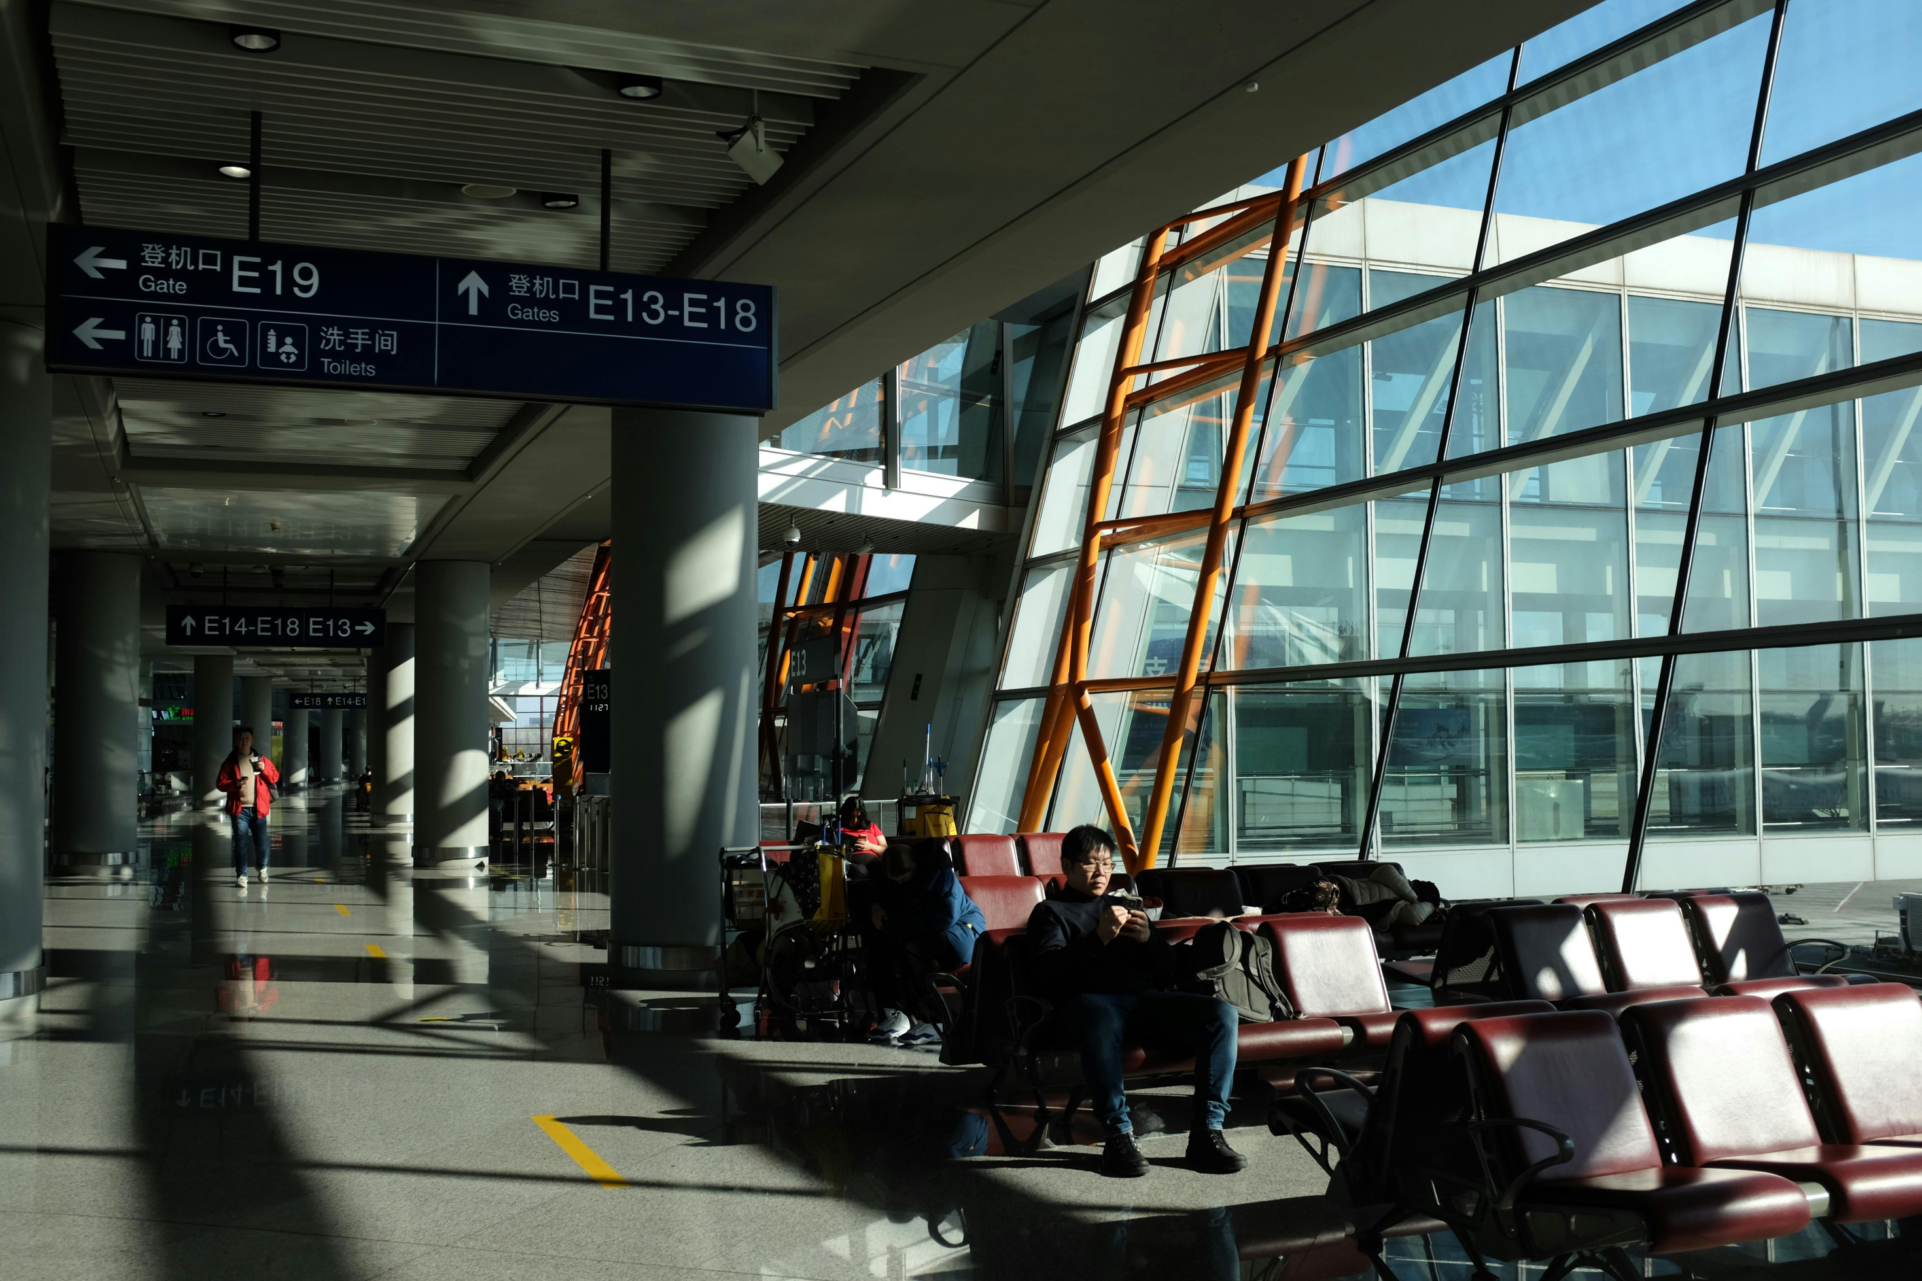
Worldwide Airlines
Home
About Us
Service
Contact
Search. . .
The Airport Flight Board & Scheduler is a simple Java application designed to manage flight information. It allows users to display, add, search, and update flights, sort flight records, generate reports, and save information in a text file.
The project demonstrates Java concepts from all six modules, including control flow, methods, arrays, object-oriented programming, file handling, and streams.
ABSTRACT

Slide 3
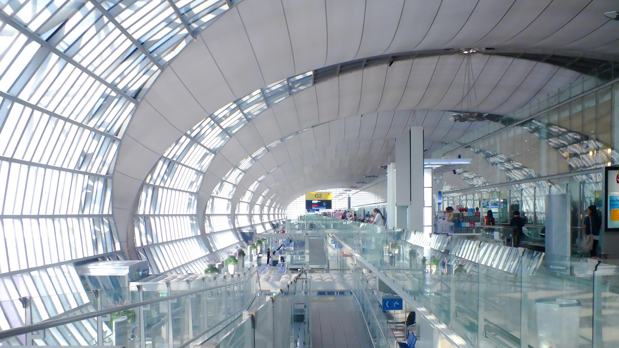
Worldwide Airlines
Home
About Us
Service
Contact
Search. . .
INTRODUCTION
Managing flight details requires organized information that's easy to access and update. This project provides a menu-driven system for basic flight management.
Objectives:
Display flight numbers, destinations, timings, and statuses.
Add new flights and search for existing ones.
Update flight status and sort flight records.
Generate simple flight reports.
Save and load flight details using a text file.

Slide 4
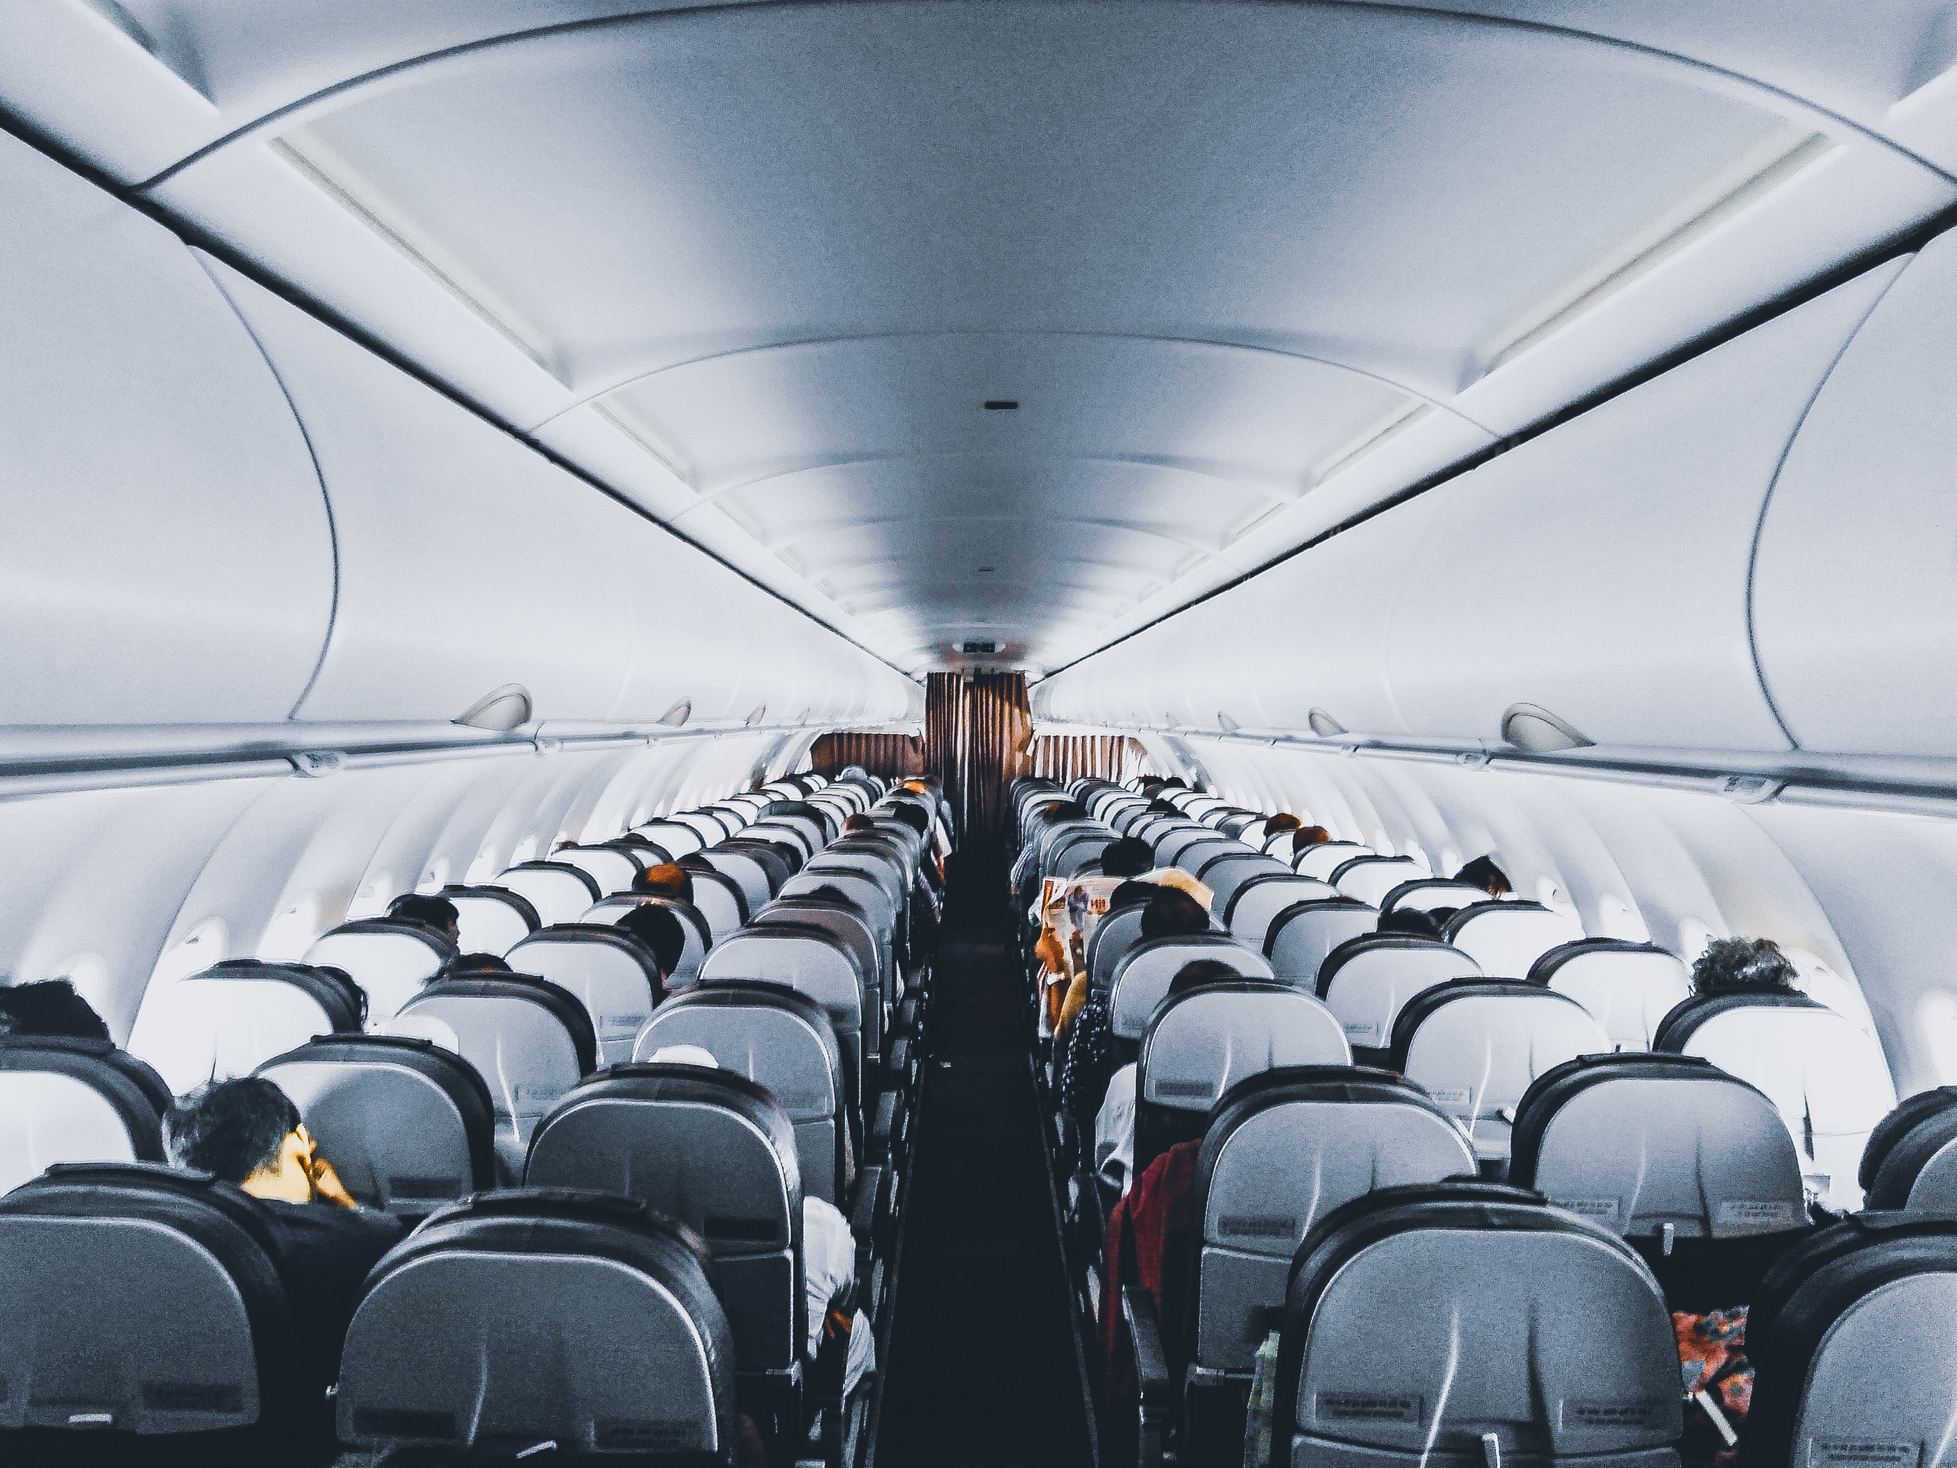
Worldwide Airlines
Home
About Us
Service
Contact
Search. . .
MODULE 1
Problem-solving: Divide flight management into smaller tasks.
Algorithm: Define the steps for adding, searching, and updating flights.
Java structure: Use a class and the main() method as the program's entry point.
Variables and data types: Store flight details using String, and menu choices using int.
Operators: Use assignment, comparison, and logical operators.
Console I/O: Use Scanner to read user input and System.out.println() to display results.
Example: The program reads a menu choice and performs the corresponding operation.
Connecting People And Places
Airports connect travelers, transportation, facilities, and every stage of the journey.

Slide 5
Worldwide Airlines
Home
About Us
Service
Contact
Search. . .
MODULE 2
if and if-else: Validate inputs and check whether a flight exists.
Nested conditions: Check multiple conditions when required.
switch: Select an operation from the menu.
default and break: Handle invalid choices and stop a selected case.
for loop: Traverse flight records.
do-while loop: Repeat the menu until the user exits.
while loop and continue: Useful for repeated processing and skipping unsuitable records.
These control-flow statements guide the program's decisions and repetition.
Connecting People And Places
Airports connect travelers, transportation, facilities, and every stage of the journey.

Slide 6
Worldwide Airlines
Home
About Us
Service
Contact
Search. . .
MODULE 3
Methods divide the program into smaller, manageable tasks.
The addFlight(), displayFlights(), searchFlight(), and updateStatus() methods perform specific operations.
Method invocation connects the menu to these operations.
Parameters pass flight details to methods.
Method overloading allows methods to share a name with different parameter lists.
A one-dimensional array stores multiple flight objects.
Array traversal and searching help locate and display flight records.
Example: search() returns the index of a matching flight or -1 if it is not found.
Connecting People And Places
Airports connect travelers, transportation, facilities, and every stage of the journey.

Slide 7
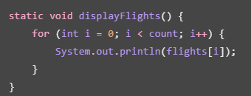

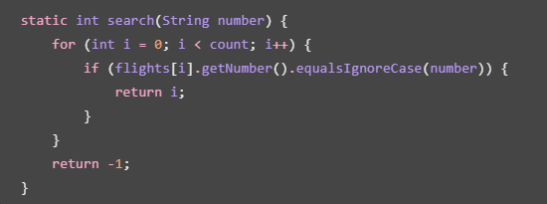
Worldwide Airlines
Home
About Us
Service
Contact
Search. . .
Recursion: A method calls itself and uses a base case to stop.
Summation and counting: Calculate totals and count flight records.
Average: Calculate an average from suitable numeric data.
Two-dimensional arrays: Store data in rows and columns.
Matrix arithmetic: The project demonstrates matrix addition using nested loops.
These concepts demonstrate additional ways to process data in Java.

Slide 8
Worldwide Airlines
Home
About Us
Service
Contact
Search. . .
MODULE 4
The Flight class acts as a blueprint for flight objects.
Each object stores a flight number, destination, time, and status.
A constructor initializes the flight details.
Private fields protect data from direct access.
Getters retrieve values, while setters update status.
toString() provides a readable representation of a flight.
The Comparable interface allows flight objects to be sorted by flight number.
Example: Each flight is created as an object of the Flight class.
Connecting People And Places
Airports connect travelers, transportation, facilities, and every stage of the journey.

Slide 9
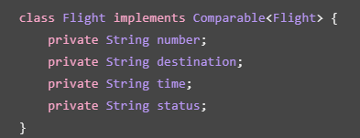
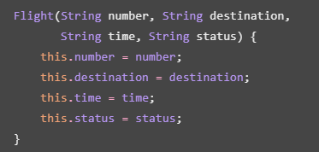

Worldwide Airlines
Home
About Us
Service
Contact
Search. . .
Exceptions can occur when the user enters an invalid menu choice.
try-catch handles invalid numeric input without immediately terminating the program.
File operations handle errors using IOException.
Input validation prevents empty flight details from being added.
Inheritance and interfaces introduce reusable object-oriented design concepts.
Example: If the user enters text instead of a menu number, the program displays an error message and asks again.

Slide 10
Worldwide Airlines
Home
About Us
Service
Contact
Search. . .
MODULE 5
Strings store flight numbers, destinations, timings, and statuses.
equalsIgnoreCase() compares text without considering letter case.
trim() removes unnecessary spaces from input.
split() separates a saved record into individual fields.
Comparable defines the natural sorting order of flight objects.
Arrays.sort() arranges flight records in order.
Searching helps locate a particular flight.
These operations help validate, organize, and process flight information.
Connecting People And Places
Airports connect travelers, transportation, facilities, and every stage of the journey.

Slide 11
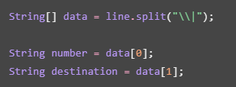
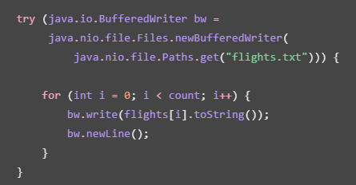

Worldwide Airlines
Home
About Us
Service
Contact
Search. . .
Path identifies the location of the data file.
Files provides methods to read and write data.
BufferedReader reads saved records line by line.
BufferedWriter writes flight details to a text file.
Each flight is stored as a record separated by a delimiter.
try-with-resources automatically closes file resources.
Exception handling manages file access errors.
Example: Flight records are saved in flights.txt and can be loaded when the application starts.

Slide 12
Worldwide Airlines
Home
About Us
Service
Contact
Search. . .
MODULE 6
Collections provide flexible ways to store and manage objects.
Lists, sets, and maps can store, identify, and retrieve records.
Generics provide type safety when working with collections.
Iteration allows records to be processed one by one.
Collections can be sorted using built-in library methods.
In the current implementation, a fixed-size array stores flight objects. Collections such as ArrayList, HashSet, and HashMap are related alternatives covered by this module.
Connecting People And Places
Airports connect travelers, transportation, facilities, and every stage of the journey.

Slide 13


Worldwide Airlines
Home
About Us
Service
Contact
Search. . .
A lambda expression provides a short way to define behavior.
A stream processes a sequence of flight records.
filter() selects flights that meet a condition.
count() calculates the number of matching records.
forEach() can perform an operation on each record.
Collectors can group or summarize records for reports.
Example: The flight report filters delayed flights and displays the total number of flights and delayed flights.

Slide 14
Worldwide Airlines
Home
About Us
Service
Contact
Search. . .
Start
↓
Load saved flight records
↓
Display menu
↓
Read user choice
↓
Add / Display / Search / Update / Sort / Report
↓
Save data when required
↓
Exit
COMPLETE PROJECT FLOW
Flight | Destination | Time | Status
AI101 | Delhi | 10:30 AM | Scheduled
6E202 | Mumbai | 12:00 PM | Delayed
UK303 | Chennai | 2:30 PM | Departed

Slide 15

Worldwide Airlines
Home
About Us
Service
Contact
Search. . .
CONCLUSION
The Airport Flight Board & Scheduler demonstrates how Java can be used to build a simple flight-management application. It combines programming fundamentals, control flow, methods, arrays, object-oriented programming, file handling, sorting, and stream-based reporting.
Future Scope
Add a graphical user interface.
Connect the system to a database.
Include real-time flight updates.
Add passenger booking and cancellation.
Generate more detailed flight reports.

Slide 16
Worldwide Airlines
Home
About Us
Service
Contact
Search. . .
OUTPUT
=== AIRPORT FLIGHT BOARD ===
1. Display Flights
2. Add Flight
3. Search Flight
4. Update Status
5. Sort Flights
6. Flight Report
7. Show Destinations
8. Save Flights
9. Matrix Addition
10. Show OOP Demo
0. Exit
Enter choice:
Thank you!

Slide 17
https://github.com/likhita-ravi/Airport-Flight-Scheduler-Java/tree/main

Slide 18
Worldwide Airlines
Home
About Us
Service
Contact
Search. . .
THANK YOU
TEAM MEMBERS
S.LIKHITA
B.HASINI
END OF PRESENTATION

